Slide 1
Team Smart Coop
Phase One Presentation
MariaCristina Todaro, Nicole Paone, Emily Cooke, Brandon Cranmer, & Billy Quinn

Slide 2

Overview
Motivation
Objective / Goals
Major Issues
Stakeholders
Customer Needs
Specifications
State of the Art Tech
Concept Generation
Concept Selection
Technical Analysis
Budget
Project Schedule

Slide 3
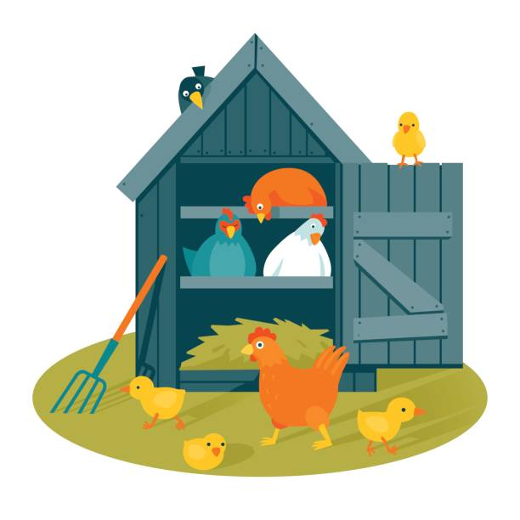
Motivation
Backyard Chicken Coops are Becoming More Popular
Daily Tasks and Constant Attention Required
Cannot Leave the Coop for an Extended Period of Time
2014 Poultry Science Article
13% of respondents said there is a “lack of reliable ‘chicken sitters’ when going on vacation”
Notes:
Billy

Slide 4
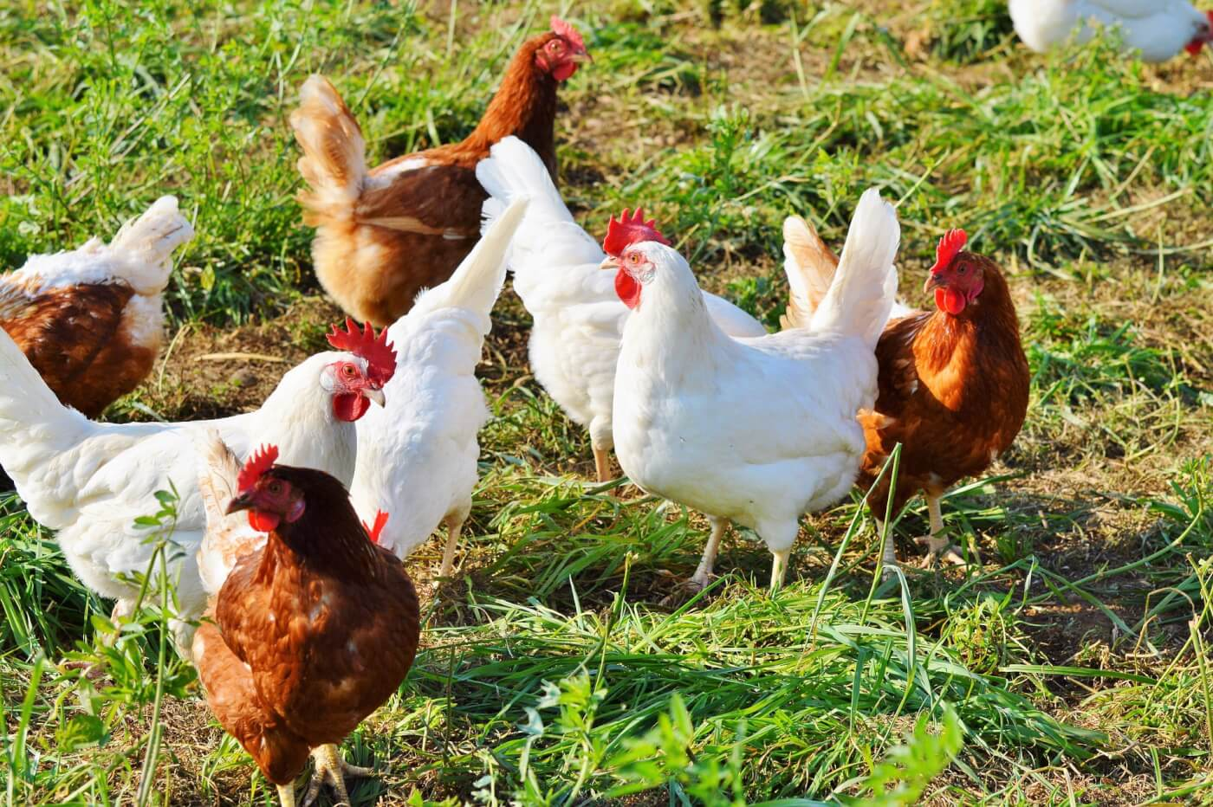
The Needs of Chickens
Coop Requirements
A safe home: the coop
Nesting box
Bedding
Coop door
Food dish
Water dish
Ventilation
Daily Tasks
Need to be let out daily
12-14 hours of daylight to lay eggs
Coop cleaning 2x week
Egg collection 1x day
Check water and clean/refill daily
Feed chickens daily
Observe chickens to make sure they are healthy
Manage the bedding
Freshen the nest boxes
Clean and sanitize the water dish
Notes:
Billy

Slide 5
The Needs of Chickens
Coop Requirements
A safe home: the coop
Nesting box
Bedding
Coop door
Food dish
Water dish
Ventilation
Daily Tasks
Need to be let out daily
12-14 hours of daylight to lay eggs
Coop cleaning 2x week
Egg collection 1x day
Check water and clean/refill daily
Feed chickens daily
Observe chickens to make sure they are healthy
Manage the bedding
Freshen the nest boxes
Clean and sanitize the water dish
Notes:
Billy

Slide 6

Objective
“To develop an automated coop that would allow the owner to go on vacation without worry.”
Notes:
Billy

Slide 7
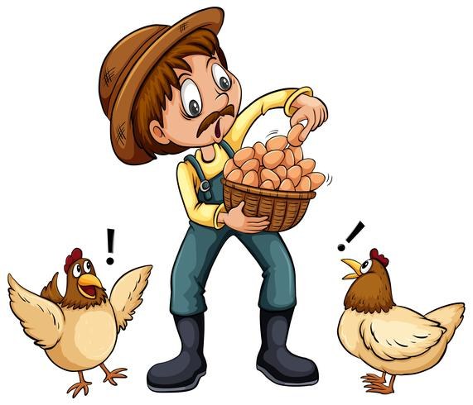
Goals
Automating Key Features:
Food and Water Dispensing
Egg Collecting
Cleaning
Door Opening
Notes:
Billy

Slide 8

Major Issues Involved
Design & Analysis
Universal Attachments vs. Automated Coop
Variety of Coops
DIY
Ensuring the Proper Living Conditions for Chicken
Designing the Automated Features of the Coop and Ensuring Safety
Possible Self Sufficient Power Supply
Prototyping & Experimentation
Testing Requires Living Animals for Accurate Results
Testing the Safety of Coop
Predator Proof
Testing Self Sufficient Power Supplies
Notes:
Billy

Slide 9
Major Issues Involved
Design & Analysis
Universal Attachments vs. Automated Coop
Variety of Coops
DIY
Ensuring the Proper Living Conditions for Chicken
Designing the Automated Features of the Coop and Ensuring Safety
Possible Self Sufficient Power Supply
Prototyping & Experimentation
Testing Requires Living Animals for Accurate Results
Testing the Safety of Coop
Predator Proof
Testing Self Sufficient Power Supplies
Notes:
Billy

Slide 10
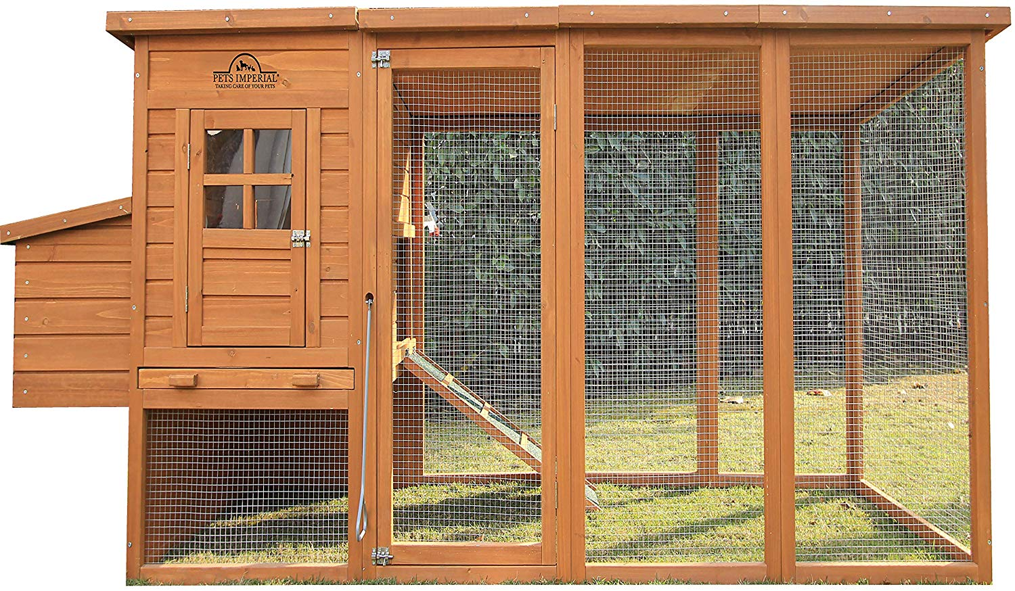
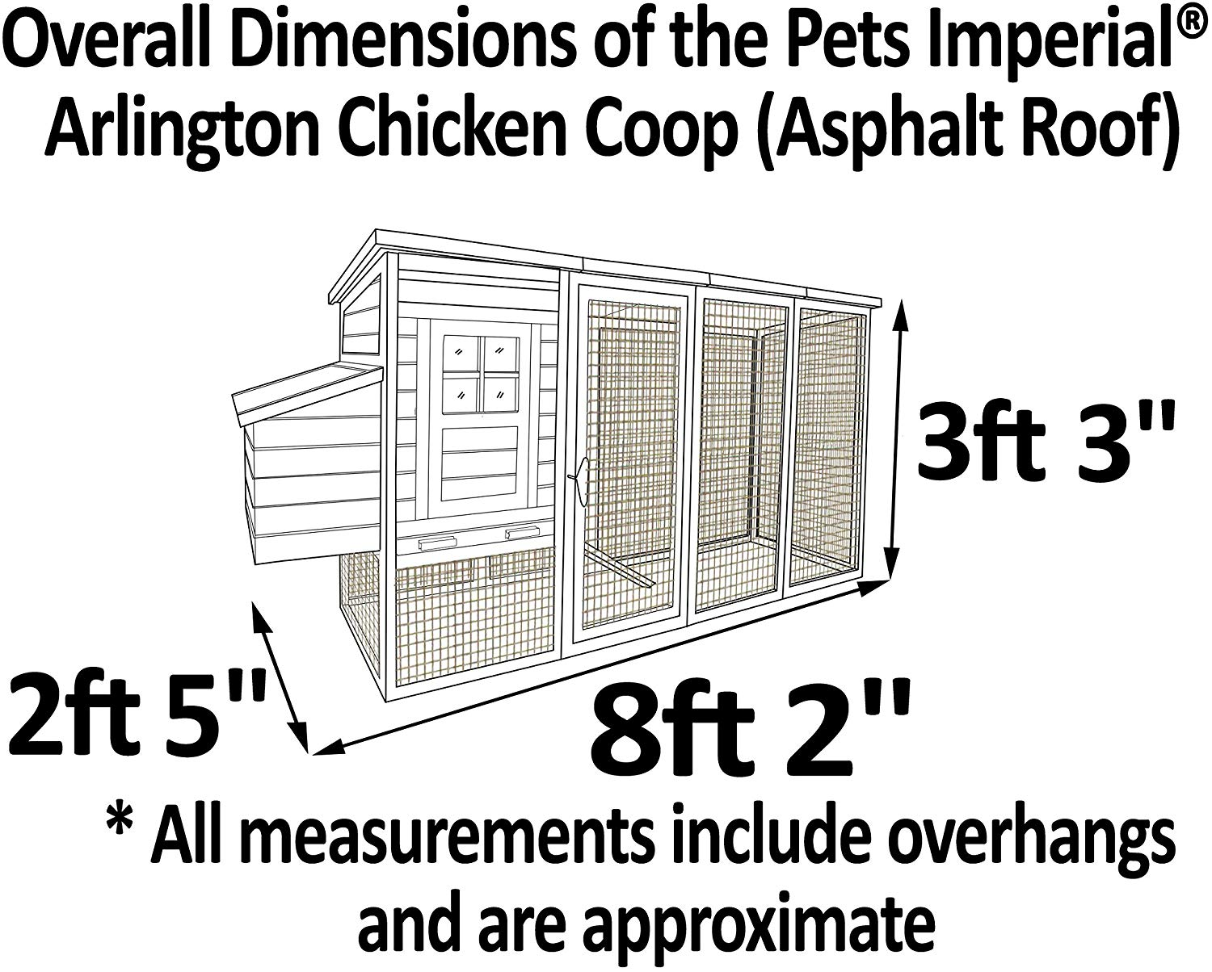
State of the Art Technology
Pets Imperial Arlington Chicken Coop
Pros:
Large Run
Hinged Roofs
Cleaning Drawer
Cons:
Coop is too small
Low Quality Material
Worn quickly
Notes:
Brandon

Slide 11
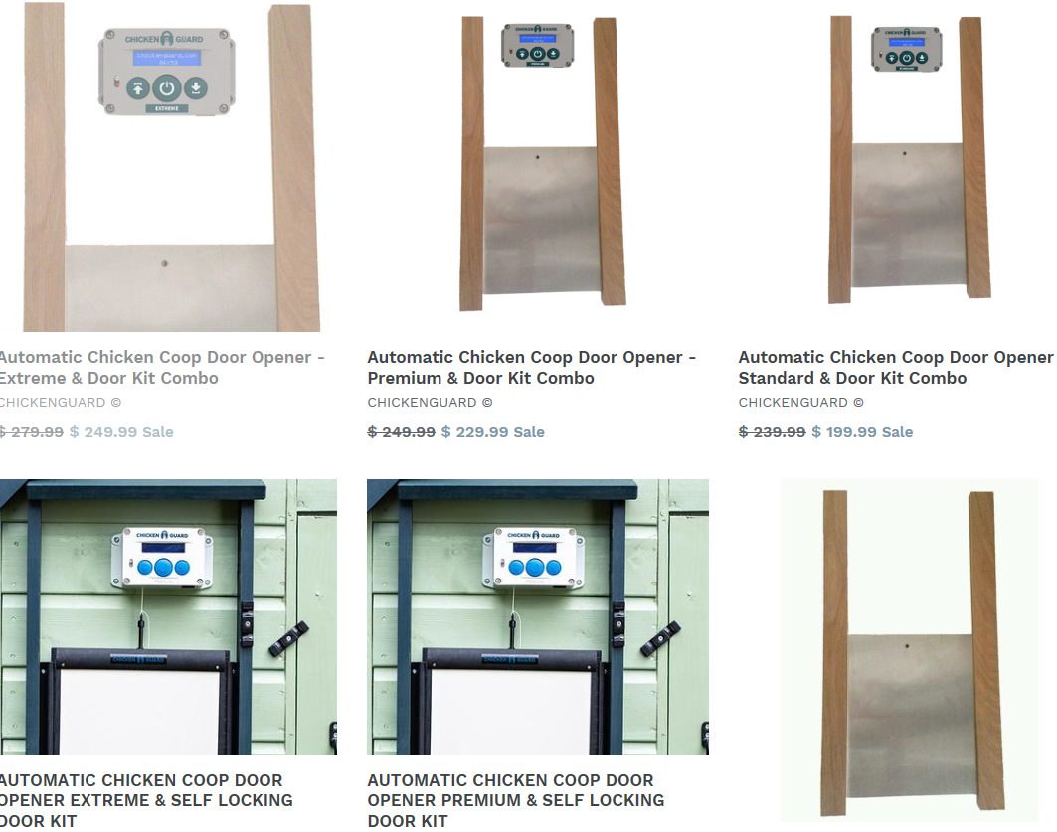
State of the Art Technology
Automatic Door Opener
Pros:
Easy to use
Sliding guillotine door with locking mechanism (varies by model)
Two different power methods
Digital timer
Cons:
Batteries (when only source of power)
Cable appears to be rope (possible area of wear)
Notes:
Brandon

Slide 12
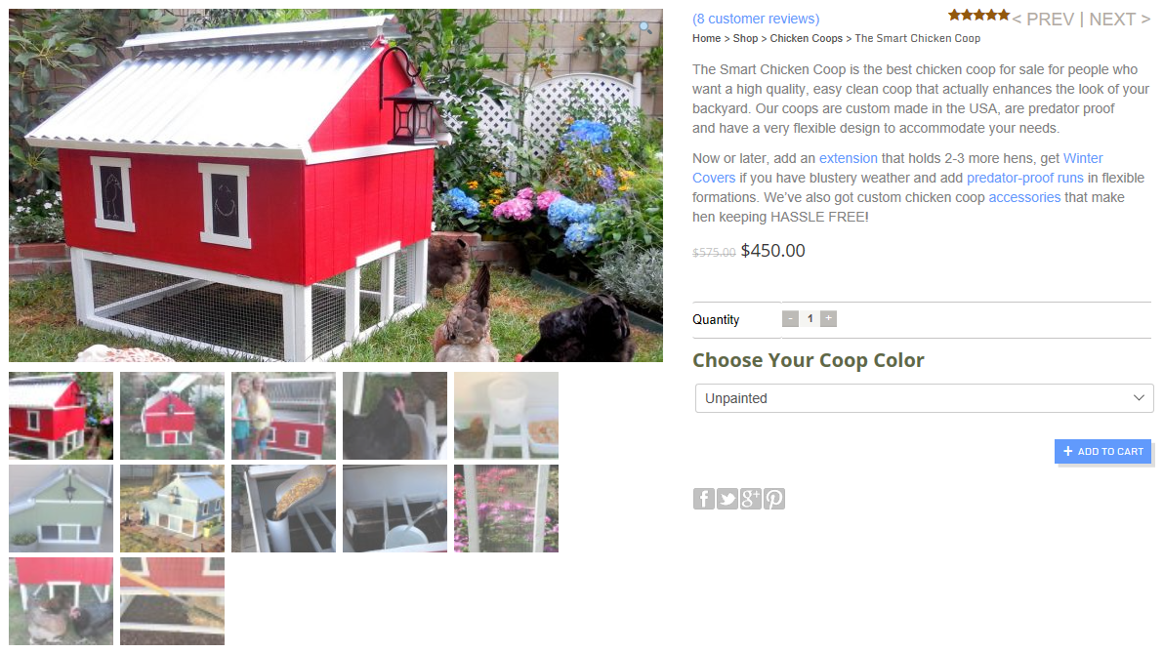
State of the Art Technology
“Smart” Chicken Coop
Pros:
Easy to access
Predator proof mesh
Made to fit amount of chickens selected
Cons:
No technology
Doesn’t really stand out compared to other coops
Notes:
Brandon

Slide 13
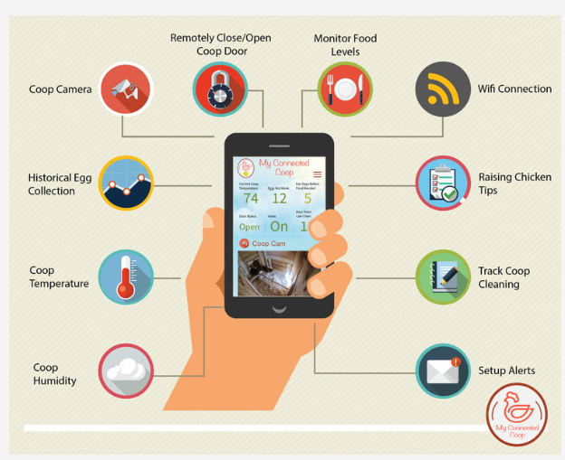
State of the Art Technology
My Connected Coop App
Pros:
Easy to use
Remotely controls door opener
Camera access to coop
Monitors different aspects of the coop
Cons:
Not easy to find / buy
Only controls the door, nothing else
Doesn’t make the coop self-sufficient
Notes:
Brandon

Slide 14

State of the Art Technology cont.
Takeaways
Dimensions
A Large Run
Hinged Roofs
Windows
Improved automatic door operation
Wireless coop monitoring
Durable
Notes:
Brandon

Slide 15

Stakeholders
Stevens Institute of Technology
Project Team
Advisor - Professor Fontaine
Senior Design Review Board
Mechanical Engineering Department
Target Customers
Current Chicken Owners
Potential Chicken Owners
Chickens (indirectly)
Potential Third Party Sellers
Suppliers of Materials
Subcontractors
Competitors
IoT
Phone Companies
Security
Legal Organizations
U.S. Environmental Protection Agency
FDA
PETA
Dept. of Agriculture
Liability
Notes:
Emily

Slide 16

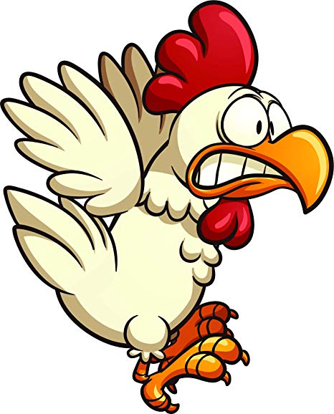
Societal and Customer Needs
Societal Needs
Residential chicken owners can to leave as necessary
Vacation
Work
Chickens are cared for properly
Customer Needs
Safety
Predator proof
Ventilated
Design
Traditional coop components
Durable
Automated performance
Egg collector
Food and water dispenser
Door opener
Coop cleaner
Price
Affordable
Notes:
Emily

Slide 17
Societal and Customer Needs
Societal Needs
Residential chicken owners can to leave as necessary
Vacation
Work
Chickens are cared for properly
Customer Needs
Safety
Predator proof
Ventilated
Design
Traditional coop components
Durable
Automated performance
Egg collector
Food and water dispenser
Door opener
Coop cleaner
Price
Affordable
Notes:
Emily

Slide 18
Specifications
Customer Needs
Safety
Predator proof
Ventilated
Design
Traditional coop components
Durable
Automated performance
Egg collector
Food and water dispenser
Door opener
Coop cleaner
Price
Affordable
Specifications
Safety
Grate size (in²)
Elevation (ft)
# of windows/vents
Design
# of traditional components
Material properties
Automated performance
# of animated components
Price
Amount paid ($)
Notes:
Emily

Slide 19
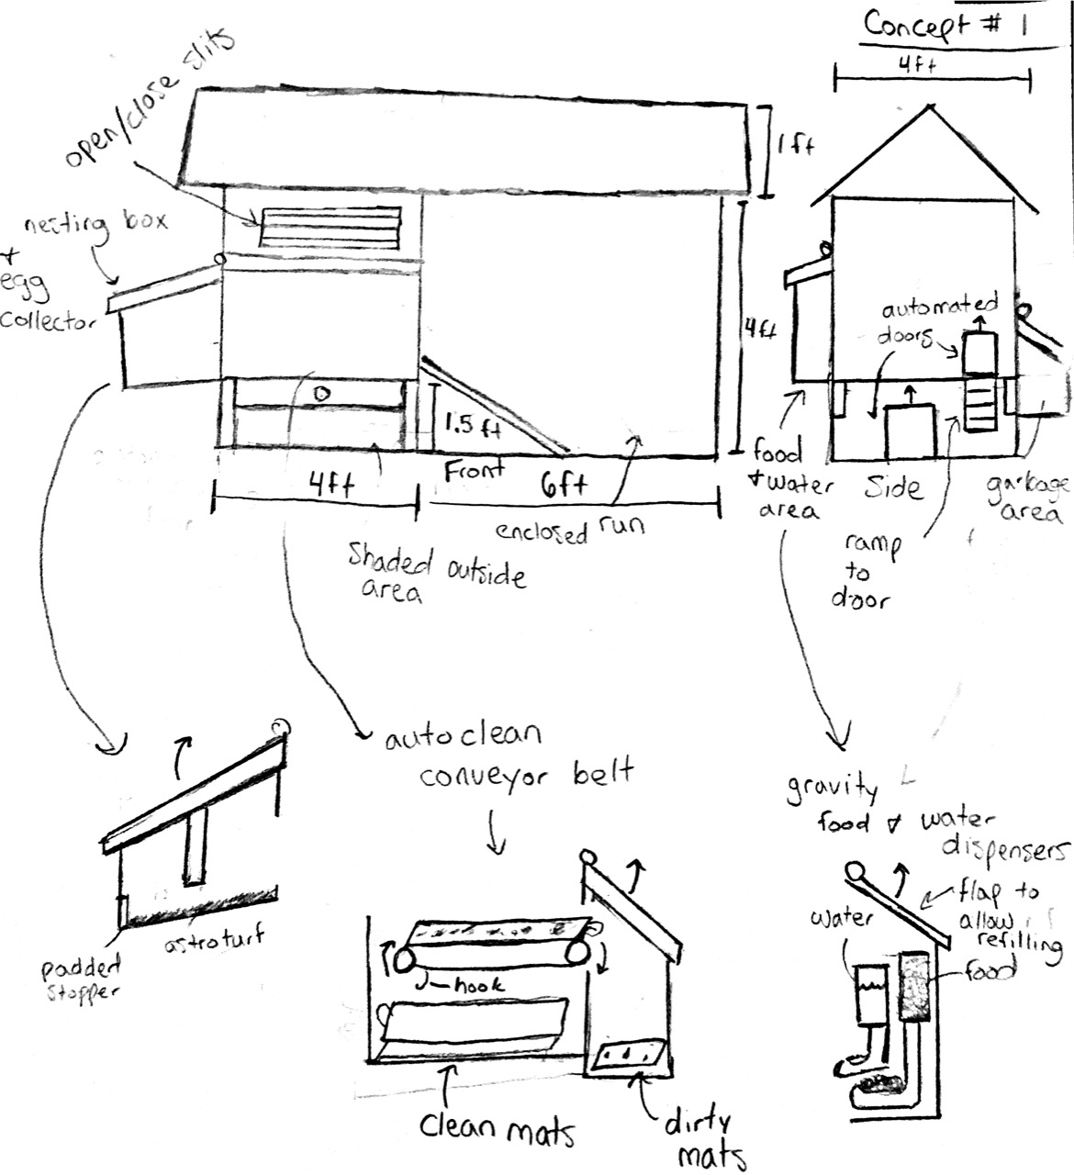
Concept Generation - #1 Billy
Key Features:
Food and Water Gravity Dispensers
Angled Nesting Box for Egg Collection
Automated Slits for Control over Ventilation
Conveyor Belt with Mats for Ease of Clean
Notes:
Billy

Slide 20
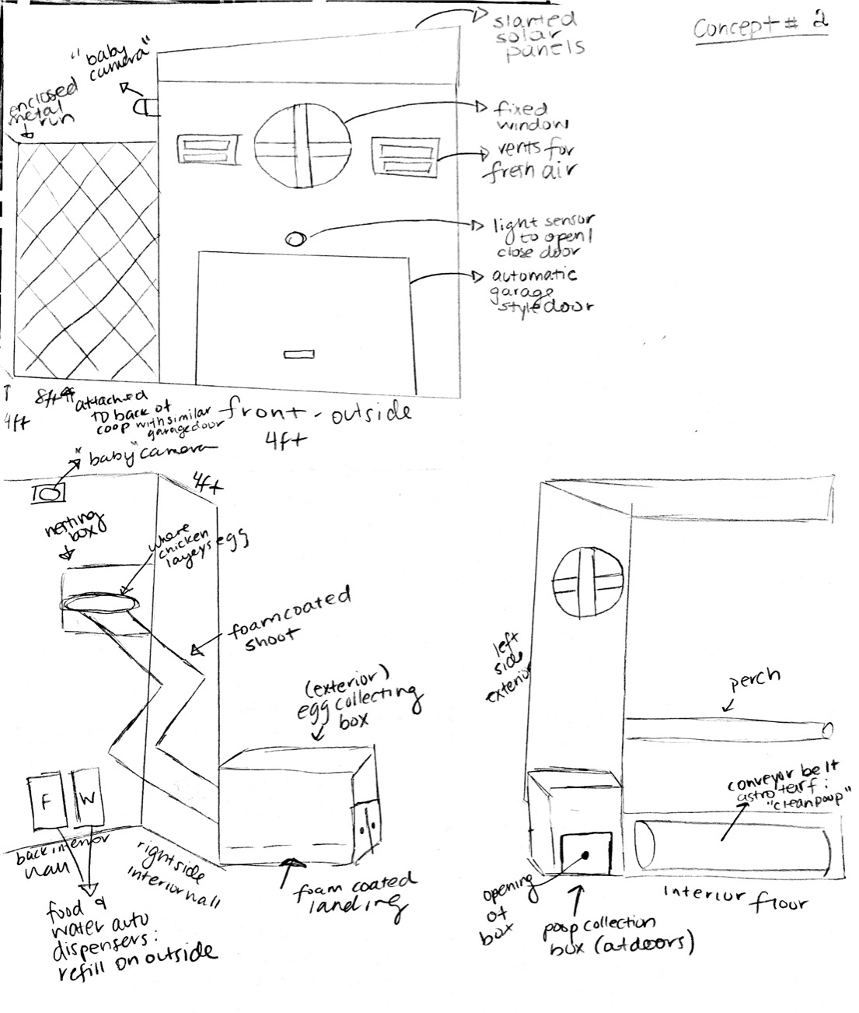
Concept Generation - #2 MC
Key Features:
“Baby” Cameras
Vents for Fresh Air
Outdoor Poop Collection Box
Slanted Solar Panels
Garage Doors
Notes:
MC

Slide 21
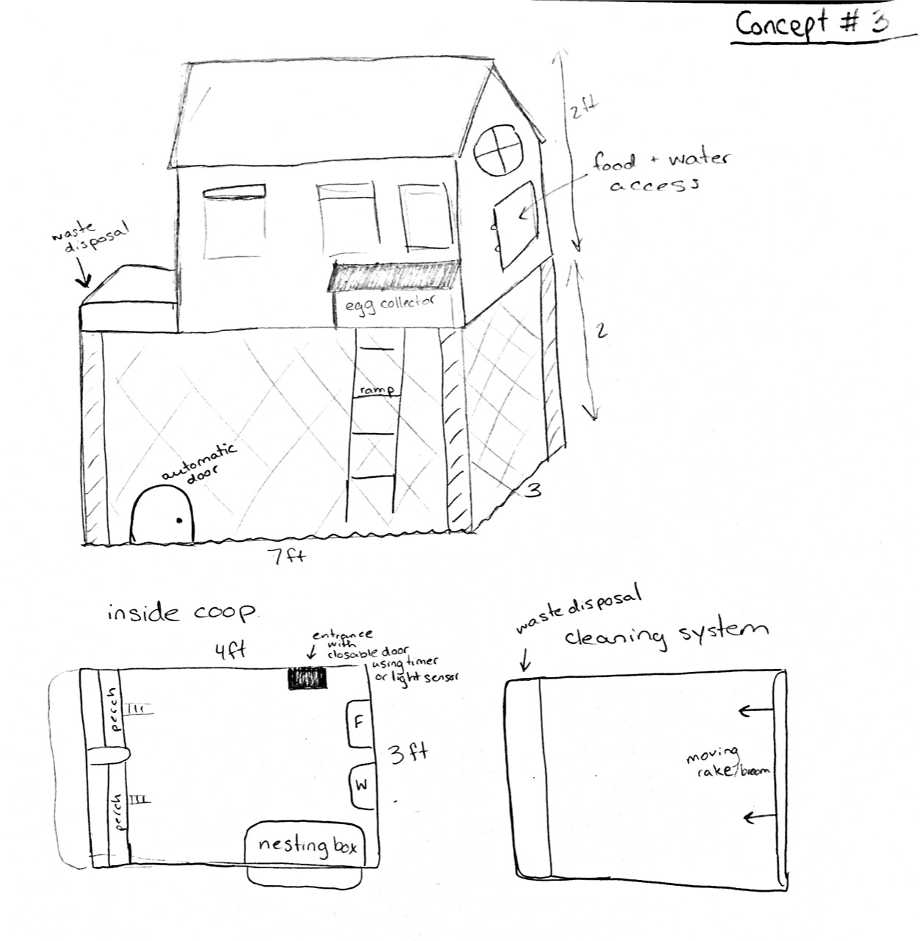
Concept Generation - #3 Emily
Key Features:
Elevation
Coop Floor Brush Cleaner
External Food and Water Access
External Egg Collector
External Waste Disposal
Notes:
Emily

Slide 22
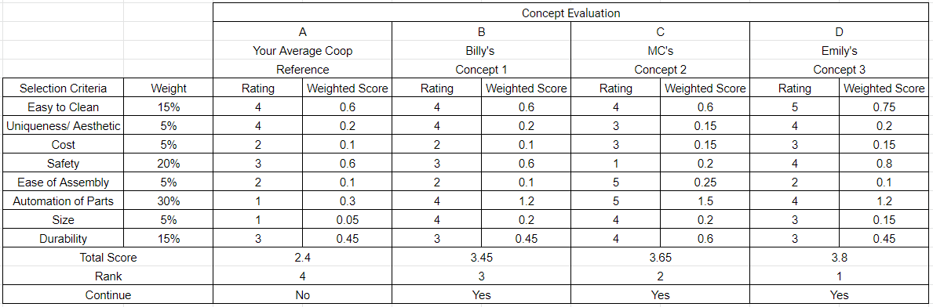
Concept Comparison
Reference Coop
Notes:
Add picture from reference coop

Slide 23
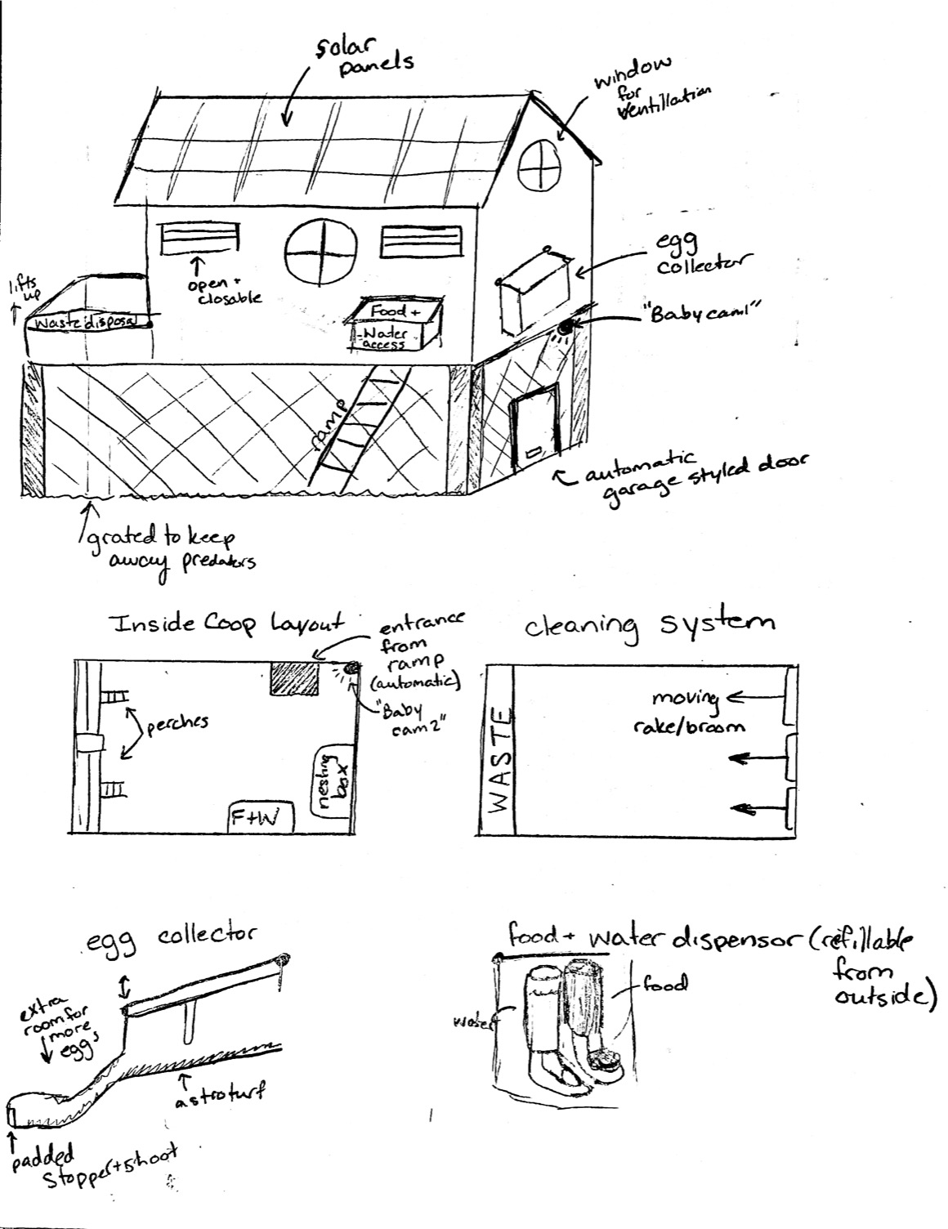
Concept Selection - Super Concept!
Key Features:
Food and Water Gravity Dispensers
Angled Nesting Box for Egg Collection
Automated vents for Control over Ventilation
“Baby” Cameras
Elevated off the Ground
Automated Brush Cleaning System
External Egg Collector
External Food and Water Access
External Waste Disposal

Slide 24
Technical Analysis
Areas for Phase 2
General Components
Coop/Run size
Weight of the chickens
Doors/Window
Size
Material stress/strain
Electrical component
Egg Collector
Size/shape
Weight
Gravity
Friction for ramp
Floor Cleaner
Sensor for detecting obstacles
Friction
Electrical Component
Food/Water Dispenser
Weight
Gravity
Notes:
Emily

Slide 25
Technical Analysis
Areas for Phase 2
General Components
Coop/Run size
Weight of the chickens
Doors/Window
Size
Material stress/strain
Electrical component
Egg Collector
Size/shape
Weight
Gravity
Friction for ramp
Floor Cleaner
Sensor for detecting obstacles
Friction
Electrical Component
Food/Water Dispenser
Weight
Gravity

Slide 26
Technical Analysis
Areas for Phase 2
General Components
Coop/Run size
Weight of the chickens
Doors/Window
Size
Material stress/strain
Electrical component
Egg Collector
Size/shape
Weight
Gravity
Friction for ramp
Floor Cleaner
Sensor for detecting obstacles
Friction
Electrical Component
Food/Water Dispenser
Weight
Gravity

Slide 27
Technical Analysis
Areas for Phase 2
General Components
Coop/Run size
Weight of the chickens
Doors/Window
Size
Material stress/strain
Electrical component
Egg Collector
Size/shape
Weight
Gravity
Friction for ramp
Floor Cleaner
Sensor for detecting obstacles
Electrical Component
Food/Water Dispenser
Weight
Gravity

Slide 28
Technical Analysis
Areas for Phase 2
General Components
Coop/Run size
Weight of the chickens
Doors/Window
Size
Material stress/strain
Electrical component
Egg Collector
Size/shape
Weight
Gravity
Friction for ramp
Floor Cleaner
Sensor for detecting obstacles
Friction
Electrical Component
Food/Water Dispenser
Weight
Gravity

Slide 29

Project Plan - Deliverables Completed
Phase 1 Deliverables
Defining the motivation
Goals
Major Issues with development
State of the Art Technology Review
Researching Commercial Applications
Needs and Specs
Stakeholder Analysis
Concept Generation and Selection
Phase 2 Deliverables
Technology Analysis
Phase 3 Deliverables
Pre-Prototype Phase
Project Planning
Notes:
MC

Slide 30
Project Plan - Deliverables Moving Forward
Phase 1 Deliverables
Defining the motivation
Goals
Major Issues with development
State of the Art Technology Review
Researching Commercial Applications
Needs and Specs
Stakeholder Analysis
Concept Generation and Selection
Phase 2 Deliverables
Technology Analysis
Phase 3 Deliverables
Pre-Prototype Phase
Project Planning
Notes:
MC

Slide 31
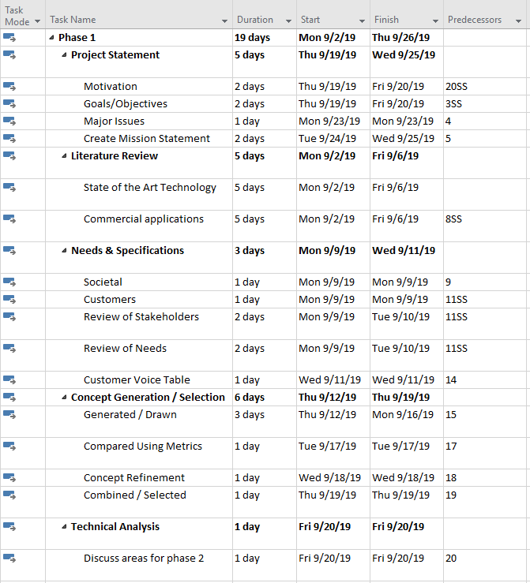
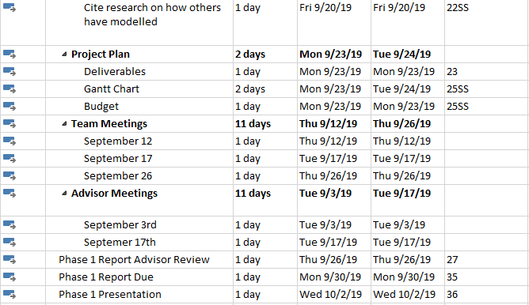
Project Plan - Gantt Chart
Notes:
MC

Slide 32
Project Plan - Budget 1
Component | Function of Component | Estimated Cost
Wood | Coop Exterior Walls | $100.00
Brush | Poop Cleanup | $20.00
Metal | Run Enclosure | $50.00
Foam | Egg Hatching | $10.00
Light Sensor | For Garage Doors | $20.00
Baby cam | To monitor chickens | $30.00
Glass | Windows | $20.00
Metal | Garage Doors | $30.00
Solar Panel | To provide power for the coop | $180.00
Vents | Fresh air | $30.00
Motors | To Control Auto Door and Rake Mechanism | $75.00
Belts | Cleaning system | $15.00
PVC | Food and Water Mechanisms | $40.00
Gear Rack | Door opener | $4.00
Gears | Cleaning system / door operator | $30.00
Raspberry Pi 4 | Control System | $40.00
Total Budget: $694.00
Notes:
MC

Slide 33
Project Plan - Budget 2
Component | Function of Component | Estimated Cost
Wood | Coop Exterior Walls | $100.00
Brush | Poop Cleanup | $20.00
Metal | Run Enclosure | $50.00
Foam | Egg Hatching | $10.00
Light Sensor | For Garage Doors | $20.00
Baby cam | To monitor chickens | $30.00
Glass | Windows | $20.00
Metal | Garage Doors | $30.00
Vents | Fresh air | $30.00
Motors | To Control Auto Door and Rake Mechanism | $75.00
Belts | Cleaning system | $15.00
PVC | Food and Water Mechanisms | $40.00
Gear Rack | Door opener | $4.00
Gears | Cleaning system / door operator | $30.00
Raspberry Pi 4 | Control System | $40.00
exterior male plug | Power | $3.00
Plastic outlet cover | Power | $50.00
Total Budget: $567.00
Notes:
MC

Slide 34
References
https://www.amazon.com/Pets-Imperial-Double-Chicken-Suitable/dp/B07N2SG7D4/ref=sr_1_7?keywords=imperial+chicken+coop&qid=1569949123&sr=8-7
https://www.amazon.com/Pets-Imperial-Arlington-Suitable-Depending/dp/B07MHXRRGS/ref=sr_1_6?keywords=imperial+chicken+coop&qid=1569949123&sr=8-6
https://cdn.lynda.com/course/618706/618706-637038169083278670-16x9.jpg
https://media.istockphoto.com/vectors/henhouse-on-a-green-lawn-vector-illustration-vector-id647203184?k=6&m=647203184&s=612x612&w=0&h=0wOrlVKdBjf5saPQneYio4Sa3iFk-mxLTiQLGehKF-Q=
https://library.kissclipart.com/20180911/que/kissclipart-learning-takeaways-clipart-take-out-learning-clip-699ef65d6b93b50d.png
https://static.vecteezy.com/system/resources/previews/000/299/523/non_2x/a-farmer-vector.jpg
http://www.projectaccelerator.co.uk/wp-content/uploads/2012/09/iStock_000007651615XSmall.jpg
Notes:
MC

Slide 35

Questions?
Notes:
MC

